Slide 1
CLARIZoN
PRESENTED BY:-
NEERAJ WALIA
&
SUKHMAN SINGH​

Slide 2
Introduction
A product comparison table contains a selection of similar items that highlights their main features. It facilitates decision making by helping a consumer focus on the similarities and differences between the items.

Slide 3
Objectives
1. Establish market position
A product comparison analysis helps you to identify where your product stands in relation to competing products in the market, thereby enabling you to make informed decisions about how best to improve or promote your product offering.
2. Identify needs and opportunities
By studying customer feedback, it is possible to identify unmet customer needs. This helps you to shape future product development so that it serves them better and gives them an improved user experience.
3. Compare features
Comparing features between products can show you where your product is leading or lagging behind its competitors. It also provides insights into customer preferences, which can help you tailor your product to meet customer demands.

Slide 4
Hardware and software
REQUIREMENTS

Slide 5
HARDWARE REQUIREMENTS
1. Processor : 11th Gen Intel(R) Core(TM) i5
2. RAM : 8GB
3. Processor Speed : 2.4GHZ

Slide 6
SOFTWARE REQUIREMENTS
Front End Tool : HTML,CSS ,JAVASCRIPT
Web Server : Apache Server 2.1.7.0 (or Above).
Back End Tool : PHP, MYSQL 5.5.8
Browser : IE 7.0/Mozilla Firefox 6.0/Cross
Operating System : Windows Operating System/Linux

Slide 7
TECHNOLOGY
HTML
CSS
JAVASCRIPT
HTML stands for Hyper Text Markup Language. It is used to design web pages using markup language. HTML is the combination of Hypertext and Markup language. Hypertext defines the link between the web pages. Markup language is used to define the text document within tag which defines the structure of web pages.
Cascading Style Sheets, fondly referred to as CSS, is a simple design language intended to simplify the process of making web pages presentable. CSS handles the look and feel part of a web page. Using CSS, you can control the colour of the text, the style of fonts, the spacing between paragraphs.
JavaScript is a very powerful client-side scripting language. JavaScript is used mainly for enhancing the interaction of a user with the webpage. In other words, you can make your webpage more lively and interactive, with the help of JavaScript. JavaScript is also being used widely in game development and Mobile application development.

Slide 8
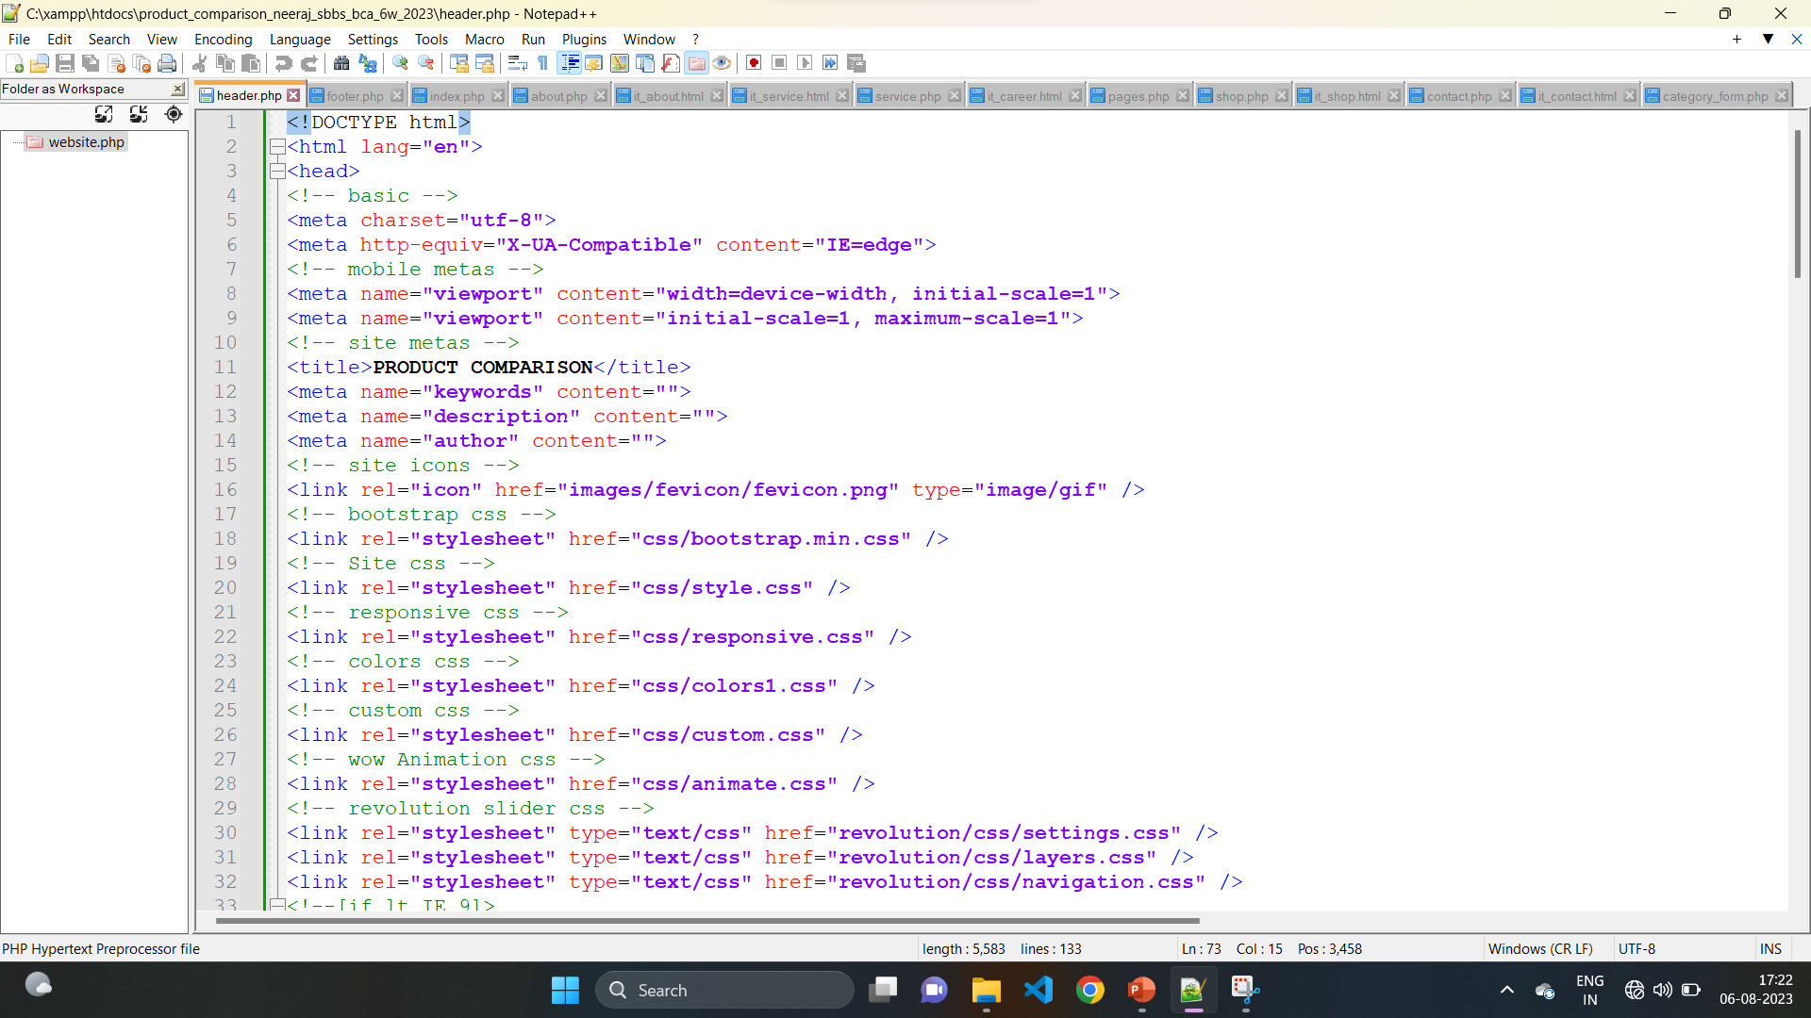
CODING

Slide 9
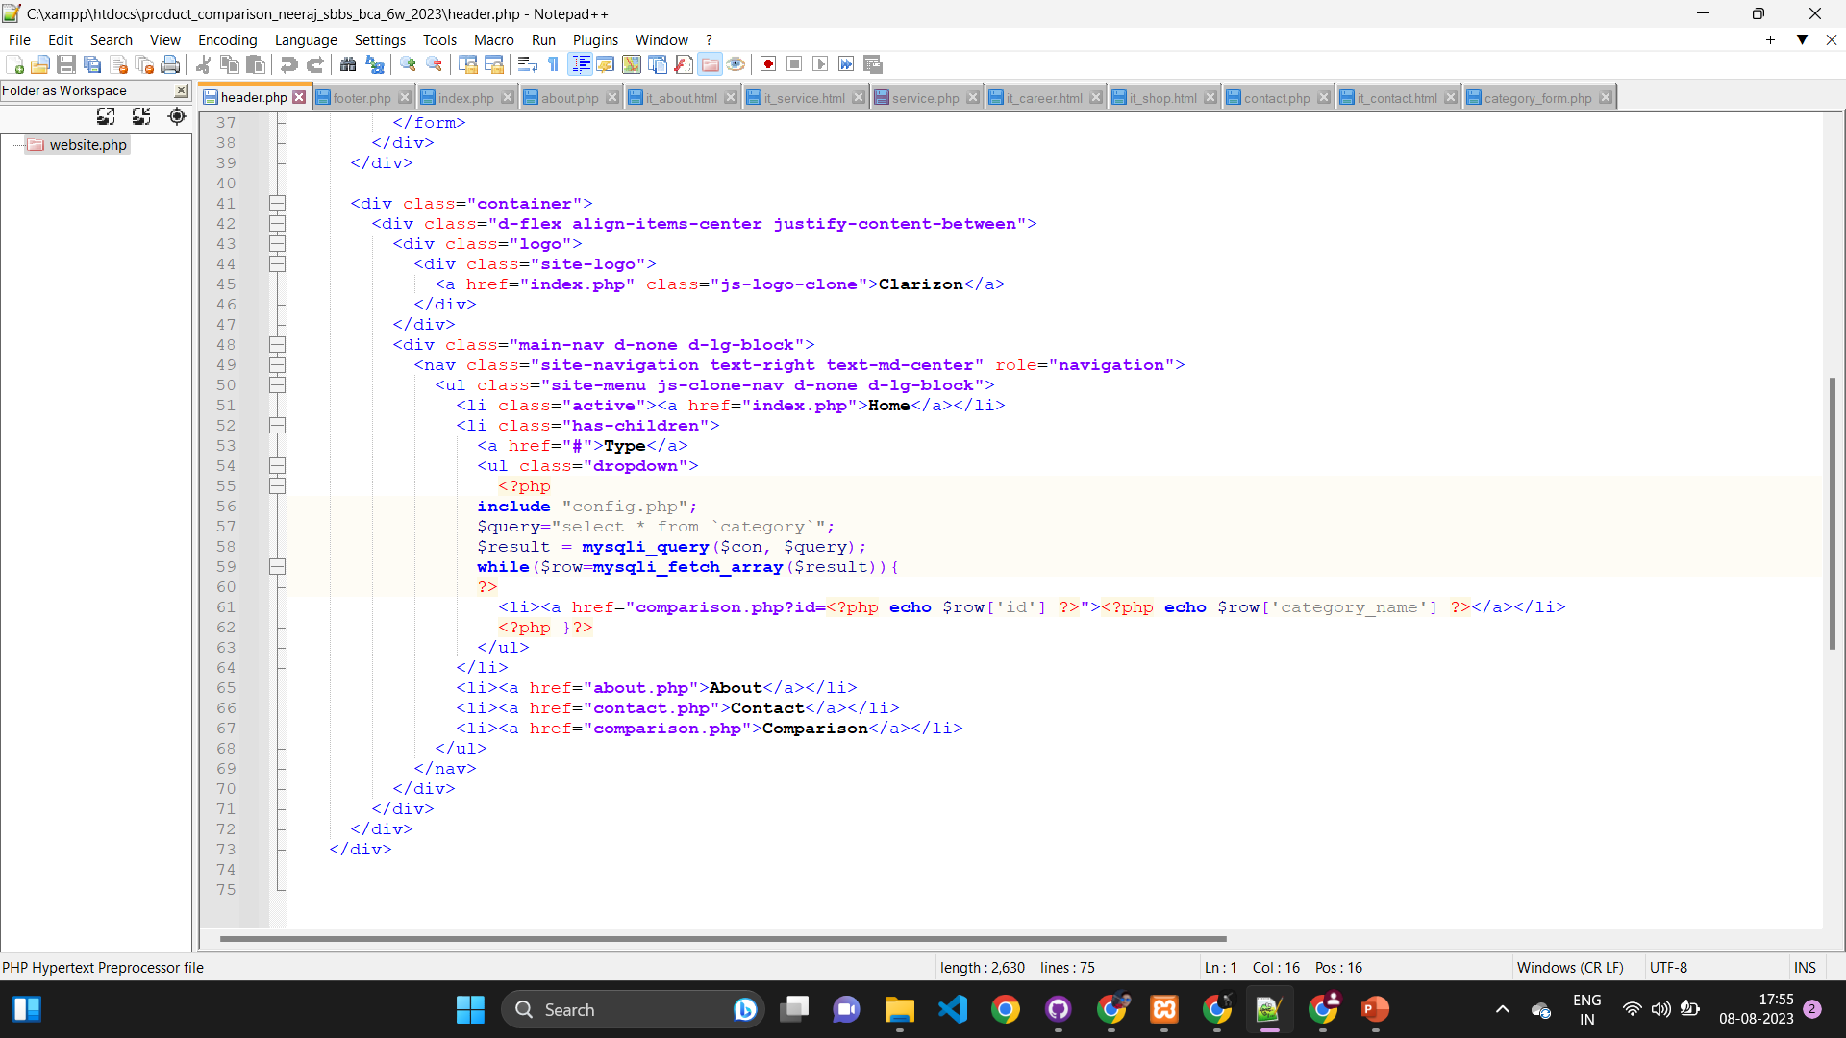

Slide 10
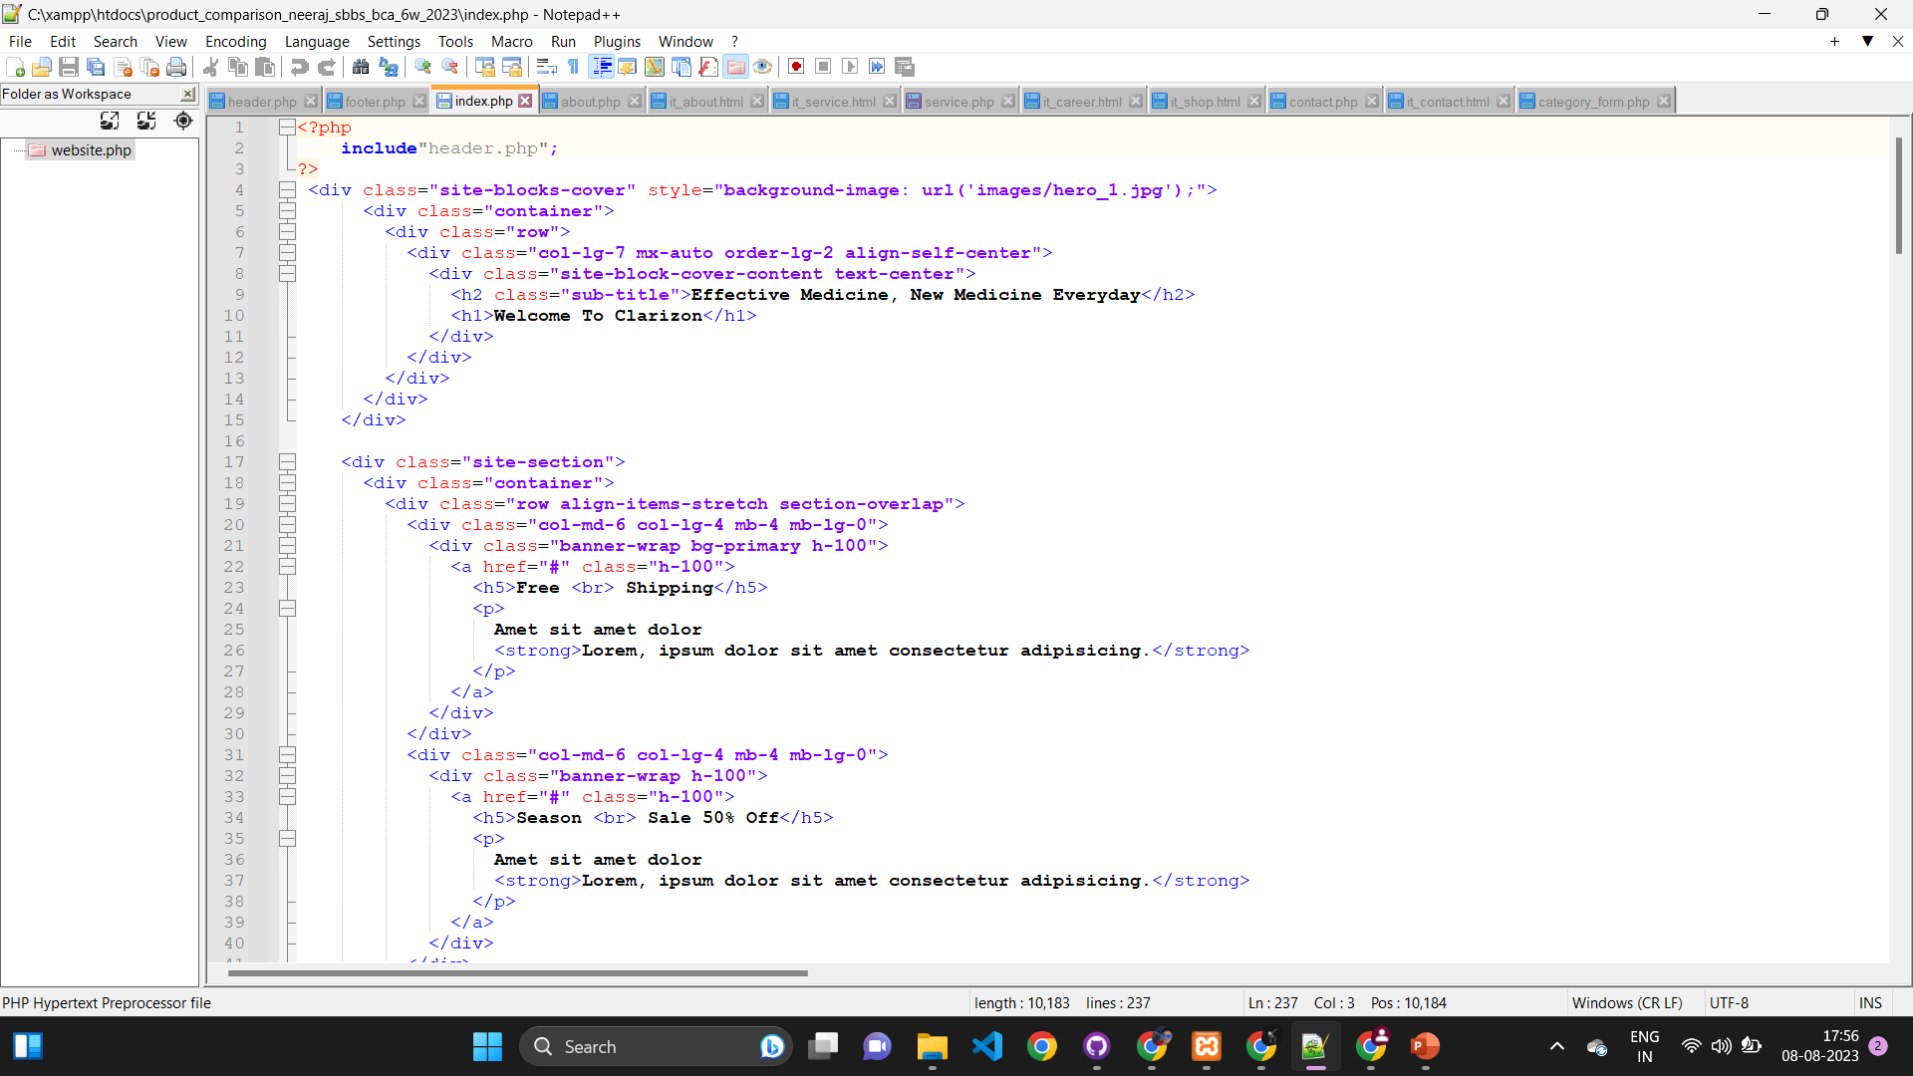

Slide 11
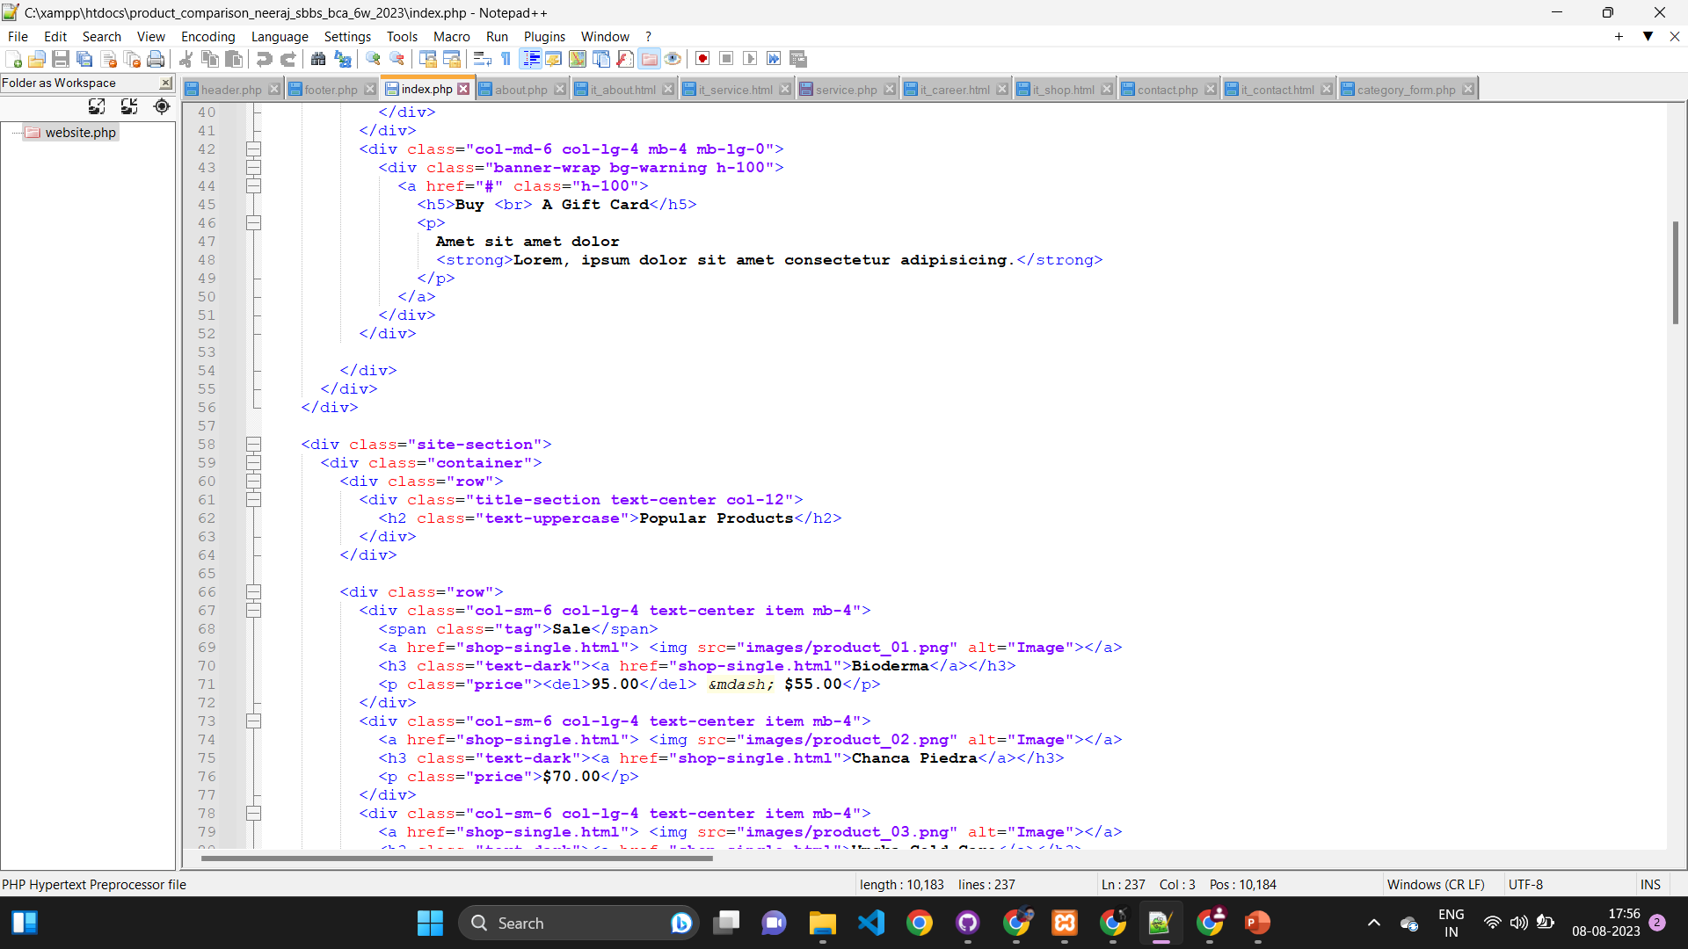

Slide 12
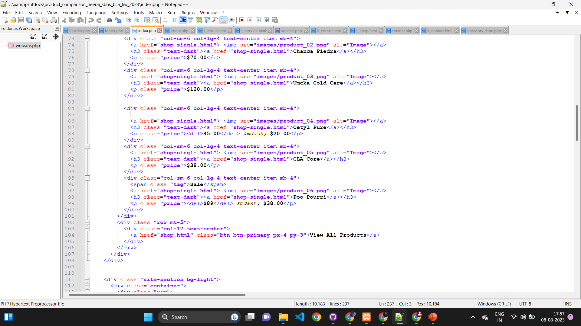

Slide 13
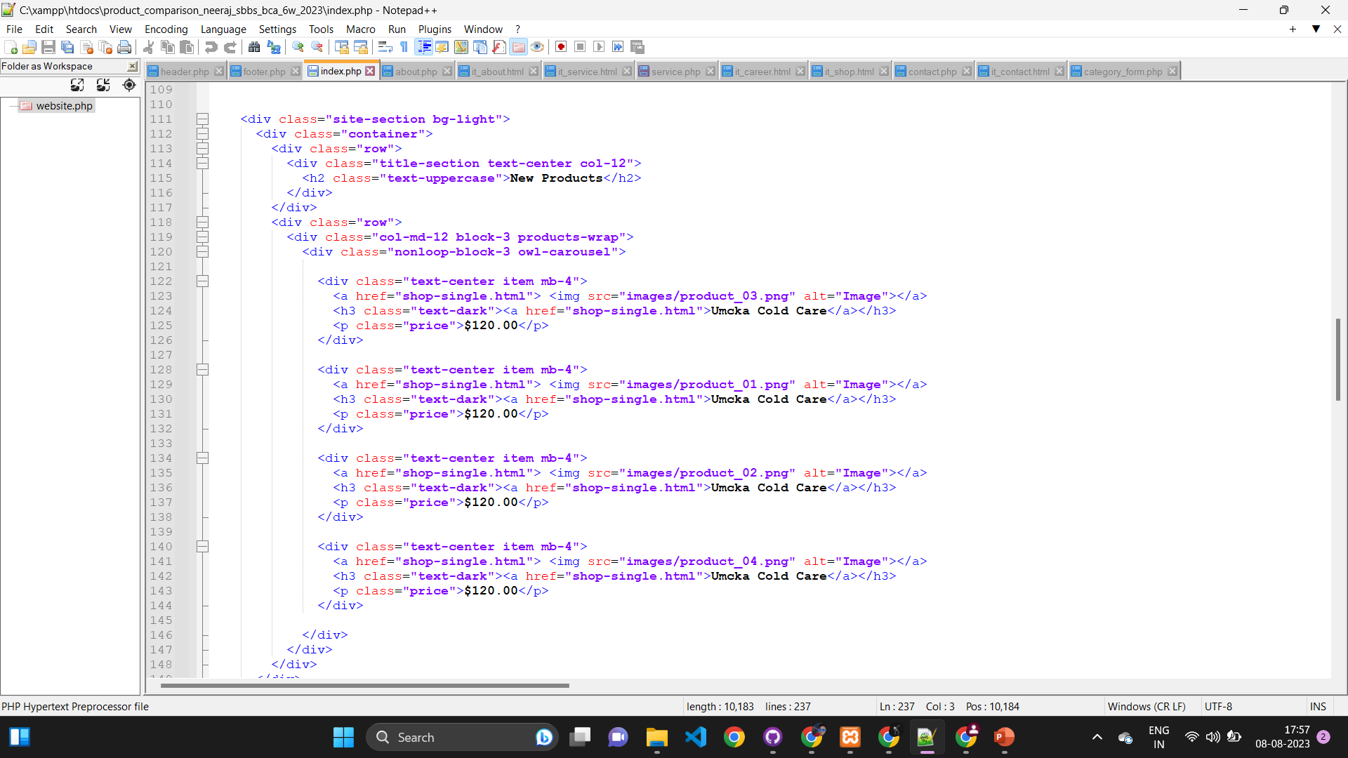

Slide 14
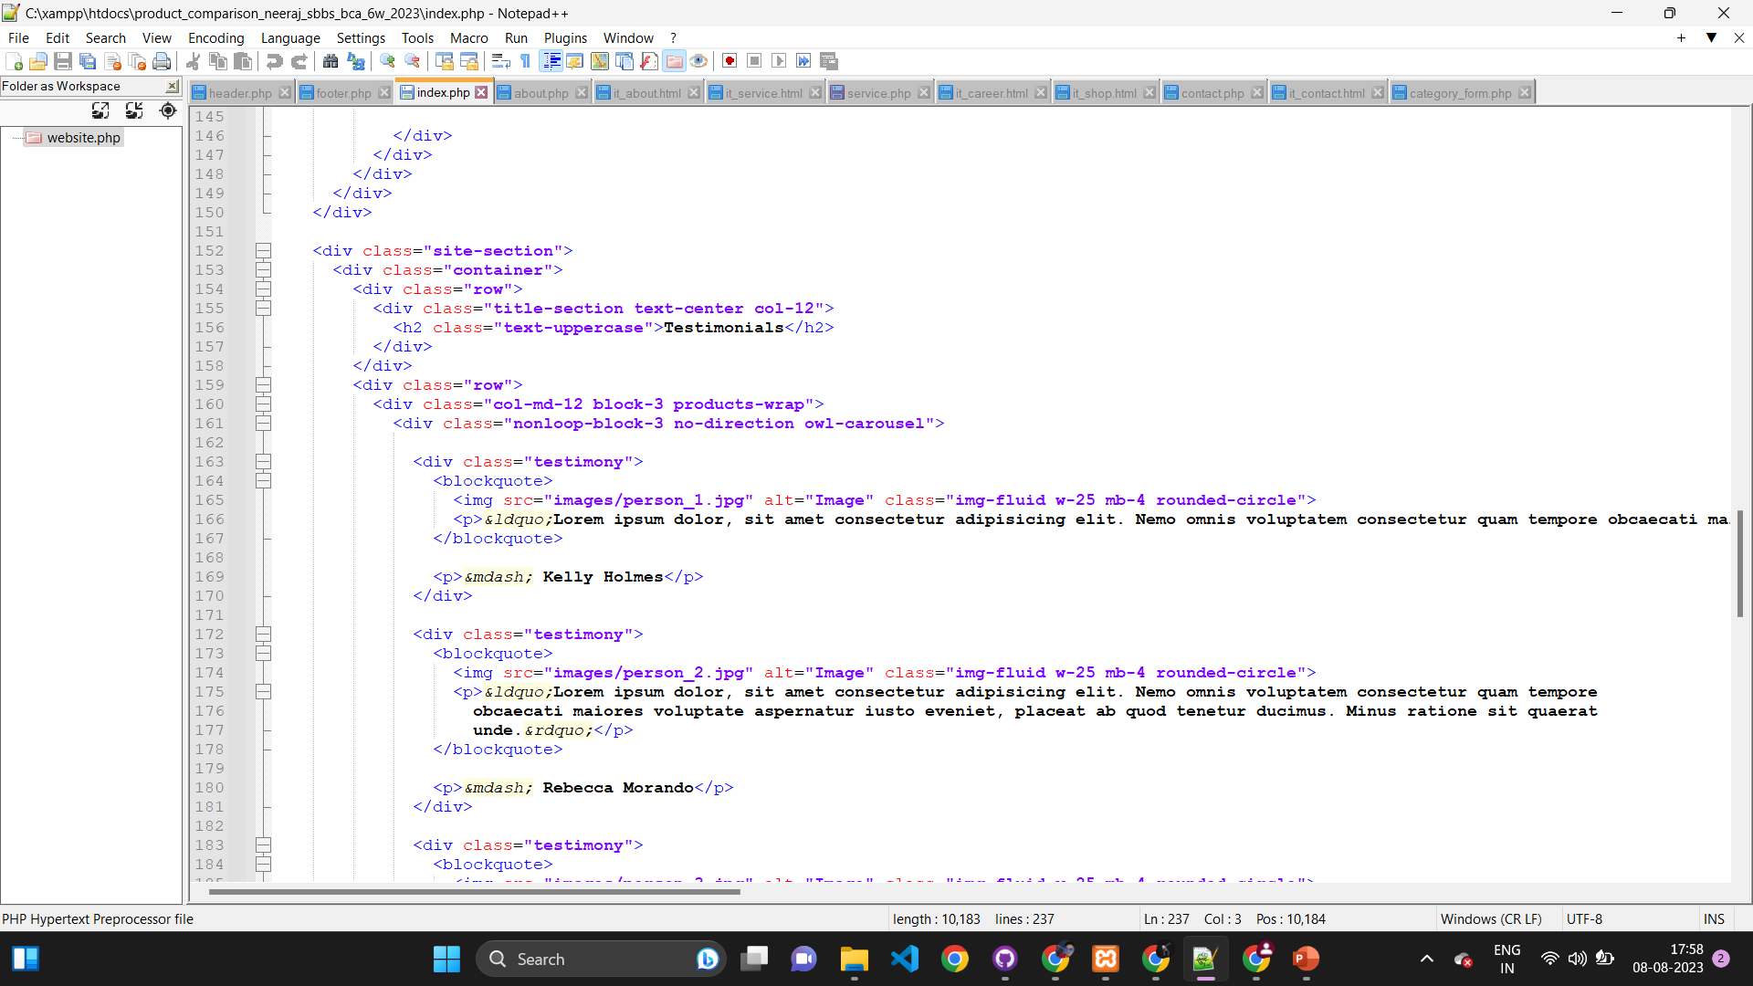

Slide 15
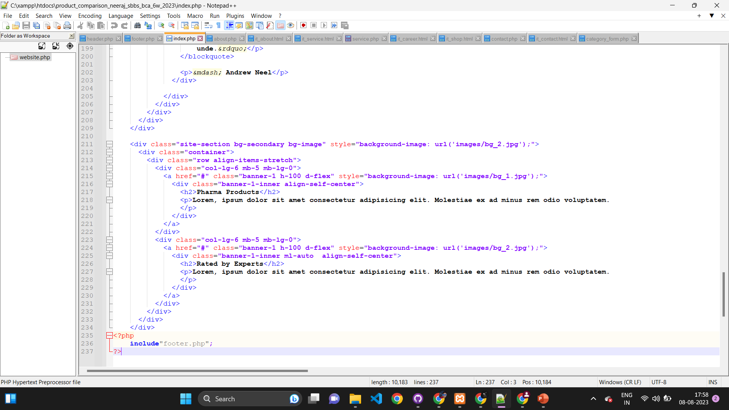

Slide 16
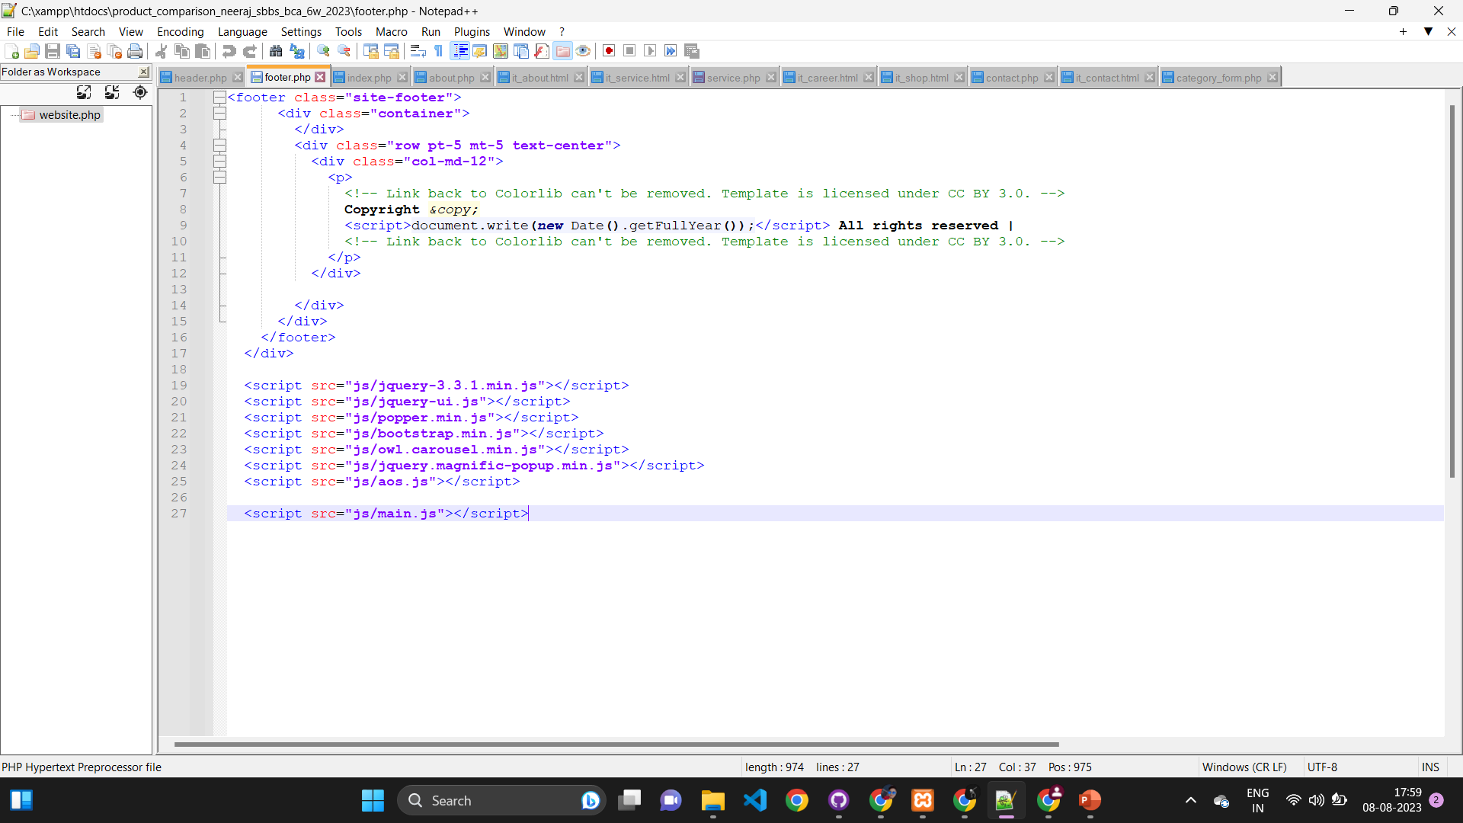

Slide 17
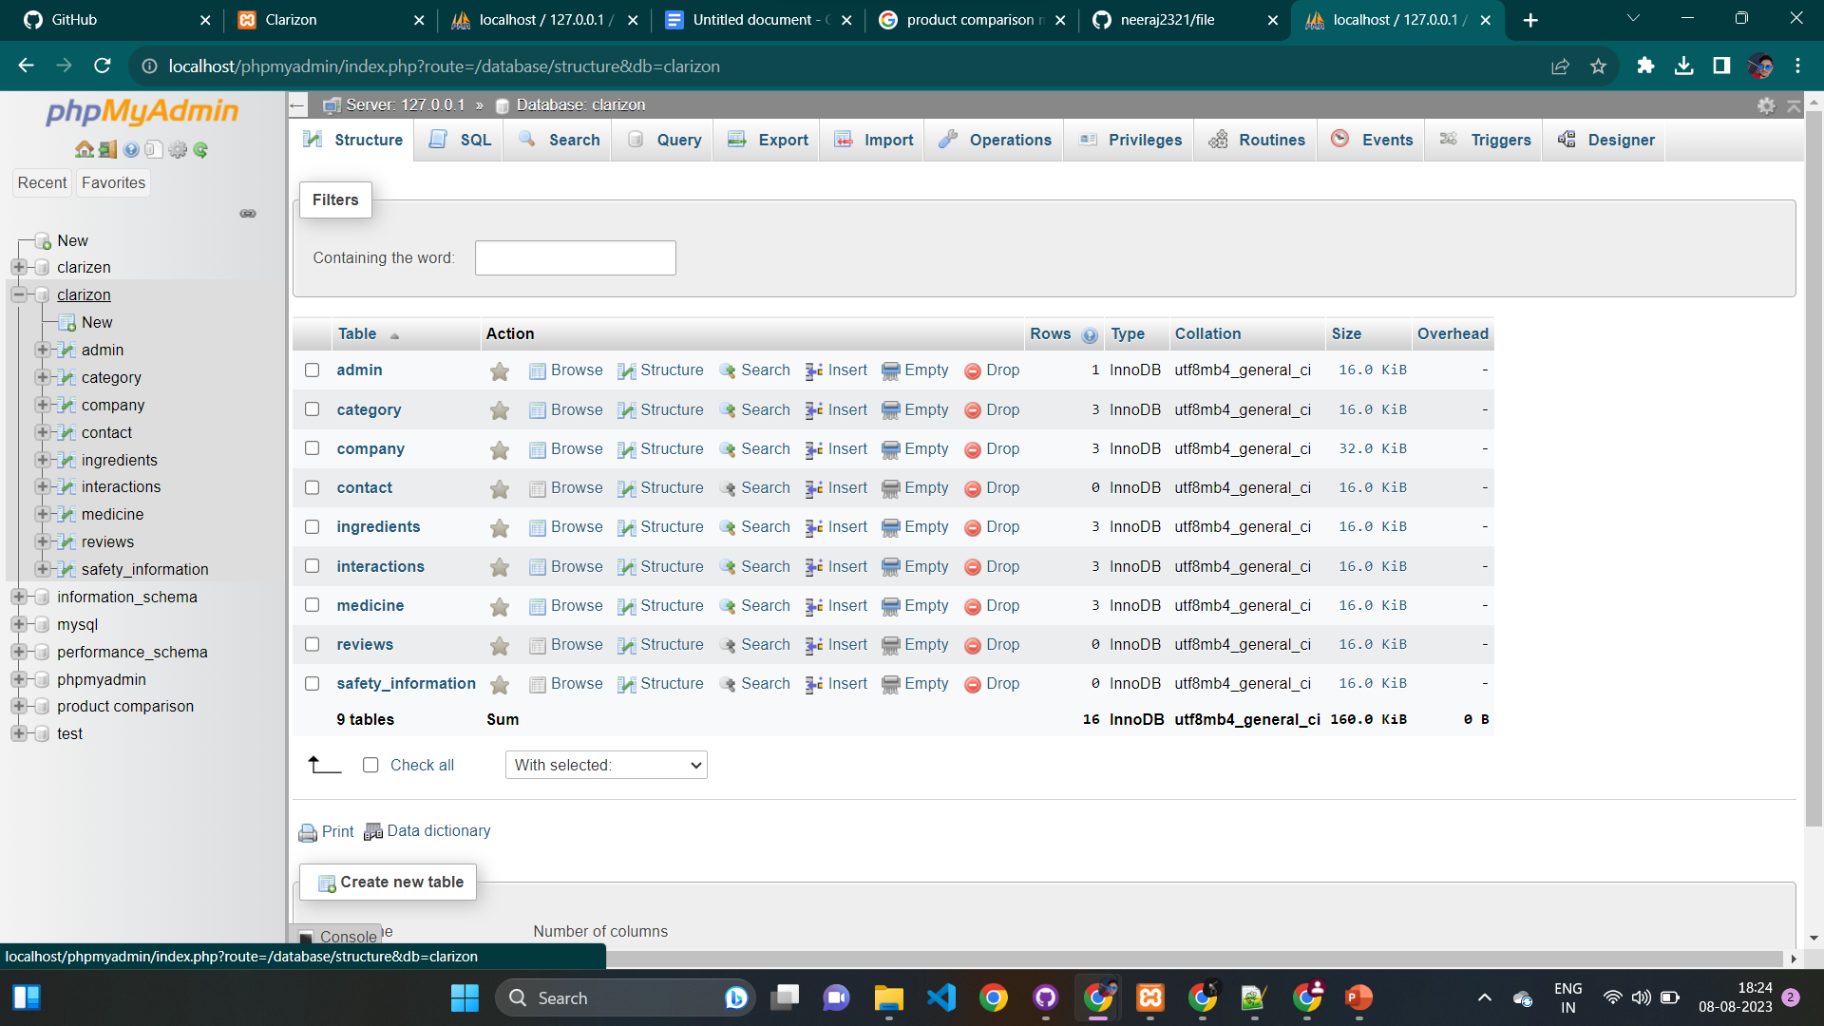

Slide 18

THANK YOU

